Slide 1
Regulatory Environment
Chapter 5

Slide 2
Engineering Council Act, 2057
Engineering Council Ain, 2055, Section 37
Main Objectives
to make engineering profession effective
to systematically and scientific regulation of Engineering Profession
to register engineers in Engineering Council

Slide 3
Categorization of Engineers
Section 2 of Engineering Council Act
General Registered Engineer (Bachelor)
Professional Engineers (Master)
Non-Nepalese Registered Engineers
Listed Engineering fields in Annex-1 of Act
Council Provide a certificate to an engineer
Engineer have to take 'oath'

Slide 4
For Academic Institutions
Section 3 of the Act states that educational institutions, organizations or any academy which intends to offer Bachelor, Master or any Post-graduate Engineering Degree will be first needed recommendation of the council before approval by government of Nepal

Slide 5
Professional Moral and Conducts
Section 4 of Act describes set of Moral
Honesty and Discipline
Loyalty and Morals
Impartiality
Performing only related Professional jobs
Never act to lower the moral in Profession
Personal Responsibility
Name, Rank and Register Number
Do not Publish statement to leave unnecessary Influence

Slide 6
Examination
Section 5 of Act states an examining committee of three member (under coordination of council member) shall examine any complaint registered against any engineer in the council
may suspend engineer under examination
produce recommendation on case
remove or reinstate the engineer

Slide 7
Provision for private practice and for employee engineers
No engineer should practice engineering profession without being registered in the council even if graduated from the institute recognized by the council.
Apply for registration
Checking of the application
Register the name
Certify the Registration (Inform if decided not to register)
Removal of Name
Cancellation of Certificate
Registering the name

Slide 8
Labor Act
Labor Act 2048 of HMG/N states that employees must be selected and appointed under section 3.4 of the Act as under:-
Required to advertise vacant positions and apply selection procedure,
Appointment letter with terms and conditions of employment- to be notify labor office,
The process applies to the contract workers and piece rate contracts,
Non-Nepalese are not allowed to employ- but they may engage with special permission from the labor department,
Nepalese workers are to be trained and non-Nepali workers need to be replaced gradually,

Slide 9
Labor or employees are recruited and appointed in the following procedures:
Acquisition:
Acquisition of labor is acquiring of labors. It is also known as hiring of labors.

Slide 10
Hiring of the labor force required for any organization. It follows the following procedure:-
Children are not allowed to work as per article 5.1 of the labor Law.
Labors are not allowed to transfer to the similar job in the company.
Ownership change of the company does not affect the employees’ service and service condition according to Article 8.
Protection of service: Employees/workers cannot be terminated without fulfillment the procedure stated in the labor act or regulation Article 10.
Temporary Layoff is permitted with half salary according to article 11.
Forced retirement at the age of 55 years is it can be extended for another 5 years, if the company needs to do.

Slide 11
Condition of work (Section 3, Article 16-20)
Working hours per day is 8 hours or 48 hours of week.
The starting time of any work shall be decided by the management of the company.
The law has provision for rest and Tiffin time for all labors after every 5 hours of continuous work and then half an hour break for Tiffin and rest.
The law also provision for over time and has to paid 1,5 times more wage but the overtime is not a compulsion.
The law states that company requires to keep attendance record.

Slide 12
Compensation (Wage- Section 4, Article 21-26)
Minimum wage, dearness allowance benefits to be set by a minimum wage setting committee(employee, HMG, management representative in equal number) - minimum wage information to be published in the gazette
Provision for annual increment- half a day wage
Payment of salary wage in time- management’s responsibility
No pay cut except in the following conditions

Slide 13
Conditions for pay cut (Article 24)
Imposed fine, pay cut for being absent
To cover the loss of the firm due to the negligence of the employee
For the benefit being provided
Excess payment
Medical benefit coverage during suspension
pay cut from the order of the court, govt. office
Tax deduction

Slide 14
Health and security provisions Section 5
Clean working environment (article 27 ka)
Enough air and light at the work place, proper waste disposal system, protection from air and noise pollution, adequate working space (15 m³ working space), safe drinking water, modern toilet facility at convenient place for both male and female employees, fire exit and extinguishes, smoke free environment, health check up each year.

Slide 15
Health and security provisions
Eye protection- use of protection devices
Protection from chemicals
Protection from fire
Protection from dangerous machine
Lifting weight – specified maximum weight
Protection arrangement for workers who work in pressure plants.
Labor depart can order firms to apply safely measures

Slide 16
Employee welfare
Provision for employee welfare
Compensation for injury or loss of body part
Gratuity, provident fund, medical expenses
Leave – public holidays, study leave, home leave, maternity leave, mourning leave, special leave
Housing arrangement (5% of the annual profit to be used for gradual development of housing facility)
Childcare provision (if more than 50 women employees)
Rest rooms and canteens (if more than 50 employees are working)

Slide 17
Disciplining (section 8)
Types of punishment: Warning, stopping annual increase, expulsion
Bad manners (आचरण), physical attacks, terrors, destroying property, theft, misuse of resources, more than 30 days absence without notice, bribes …. (Article 51)
Clarification after having proof or evidence
Labor department can dismiss the employees
Managers or proprietors to be punished
Employees may appeal to the court within 35 days

Slide 18
Resolving labor disputes
Provision for labor court
Personal claim or complain
To management, if not resolved
To labor office to be resolved within 15 days, if not then by labor offices chief within 7 days
If the decision is not acceptable, employee may file the case to the labor court.

Slide 19
Process for collective bargaining
Claim or demand to be signed by 51% of the employees/workers and to be submitted to the management,
Negotiation between the representatives of two parties – agreement within 21 days
If not resolved negotiation in the presence of labor office
If not resolved negotiation (individual or committee) to be appointed and conflicts to be resolved within 15 days.
If the decision of the negotiation is not acceptable, parties may appeal to the HMGN within 35 days
If decision is not made within 60 days, workers may go on strike following the procedure stated in clause 76

Slide 20
Process to go on strike
Required to inform before going on strike with demand (proposal) approved by 60% of the employees. Written information 30 in advance to the management, labor office, local administrator
If the above procedure is not followed, the management may close the operation by receiving the permission from the government.
If the laws have restricted employees of some enterprises of public importance, employees cannot go on strike.

Slide 21
Collective bargaining
The outcome of the collective bargaining agreed and signed by the both parties, should be considered as law for the concerned parties
The signed contract shall be effective from the date of registration in the office or from the specified date.
Concerned parties may report the labor office if the signed agreement is not followed – labor office may implement the collective agreement following due process.
HMG can order to stop strikes in unusual circumstances

Slide 22
Personal and Financial regulation, Tippani System.
The difference in the performances among the organization is because of the personnel employed and maintained in there, others – such as equipment, plants and materials required for various levels of work are the same as specified for the work.
This indicates to load more emphasis on the people employed in the organization.
But how to acquire the most appropriate personnel for the jobs identified is the problem.

Slide 23
In Nepal, the jobs that have to be done is described in a job description, although most of the offices and post do not have job description as such.
This is so happened because the acquiring people in an organization used to be through relatives alone.
The employed person used to learn all tricks and trade of the job later and accordingly used to be promoted. Recruiting and selecting was not a systematic and scientific.

Slide 24
In Nepal, the needs and types of manpower is initiated through Tippani, a kind of notes on the issue concerned expressed by various levels of responsible positions.
The system of hiring or acquiring manpower is basically as per Human Resource Acquisition described in the previous lesion, but recording and maintaining inventory of the staffs (human resource) need to be initiated in offices.

Slide 25
Intellectual Property Rights
Intellectual Property is the Right you have on your creation, like a film, a musical composition, an invention, a brand name etc.
Like any other real property, you have the right to own and protect the creation of your mind. Such a Right is called an Intellectual Property.
If you have an Intellectual Property (IP), over any of your works or ideas, others need to take your permission before using it.

Slide 26
Otherwise, you can initiate a legal action against such persons.
Intellectual Property refers to the right over the intellectual work and not the work itself.
The work can be either artistic or commercial.
The artistic work comes under the category of the copyright laws, while the commercial ones, also known as industrial properties, are ruled by patents, trademarks and industrial design rights.

Slide 27
Copyright laws deals with the intellectual property of creative works like books, music, software, paintings etc.
Industrial properties cover those created and used for industrial or commercial purpose.
As stated earlier, intellectual property is categorized into various types as per the nature of work.

Slide 28
The most common types of intellectual property are copyright, trademarks, patents and industrial design rights.
Let’s look forward at the different types of intellectual property rights.

Slide 29
Copyrights
A copyright is a right conferred on the owner of the literary or artistic work.
It is an exclusive right to control the publication, distribution and adaptation of creative works.
The right lies with the owner-cum-copyright holder for a certain period of time.
As time lapses, the work can be republished or reproduced by others.

Slide 30
Usually, the time span of a copyright extends through the entire life of the owner and lasts up to a period of about 50 to 100 years after death.
In case of anonymous work, the right lasts for 95 years after publication or 120 years after the creation.

Slide 31
Trademarks
Trademark is a symbol, which is generally used to identify product, which indicates its source.
A trademarks can be a combination of words, phrases, symbols, logos, designs, images or devices used by an individual, legal entity or business organizations to distinguish their product from the others.

Slide 32
For example you can identify the products of NIKE Inc, through their logo, which is embossed on their products.
Once registered trademarks are protected legally and the owners can sue persons who use their trademarks.

Slide 33
Patents.
Patents are rights related to new innovations.
This right is conferred on persons who invent any new machine, process, article of manufacture or composition of matter, biological discoveries etc.
In order to grant a patent, the invention should fit into the following criteria, which may differ from country to country.

Slide 34
In general, the invention must be new, inventive and should be useful or can be applied in industries.
The person who receives a patent for his invention has an exclusive right to control others form making, using, selling or distributing the patented invention without permission.
Generally, the time limit of a patent is 20 years from the date of filing the application (for the patent)

Slide 35
Industrial Designs
These rights also come under intellectual property and protect the visual design of objects that are not purely utillitarian, but have an aesthetic or ornamental value.
It can refer to the creation of a shape, color, pattern or a combination of all these things.
It can be an industrial commodity or a handcraft.

Slide 36
The design can be either two-dimensional (based on patterns, colors, and lines) or three-dimensional (as per shape and surface).
An industrial design right is conferred after considering factors like novelty, originality and visual appeal.
The person who has an industrial design right has the excusive right to make or sell any object in which the design is applicable.
The right is conferred for a period of 10 – 25 years.

Slide 37
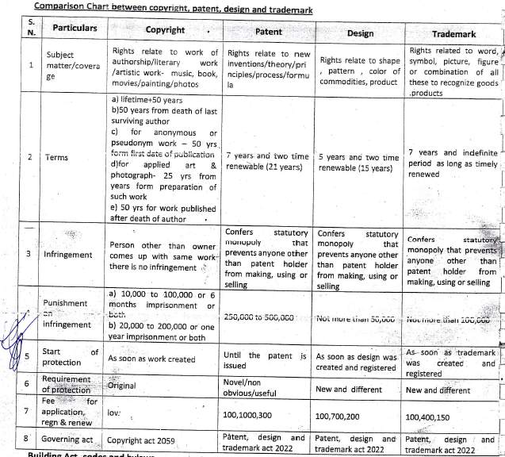

Slide 38
Building Act, Codes and bylaws
Regulating building construction activities was essential for the purpose of keeping buildings safe from earthquake, fire and other natural calamities.
For fulfilling this purpose Building Act 2055 (1998) was promulgated (circulated) and meantime, Building rules 2062 (2005) also came into operation.
With reference to building rules, building are to be constructed following National Building Code 2060.

Slide 39
List of codes in NBC

Slide 40
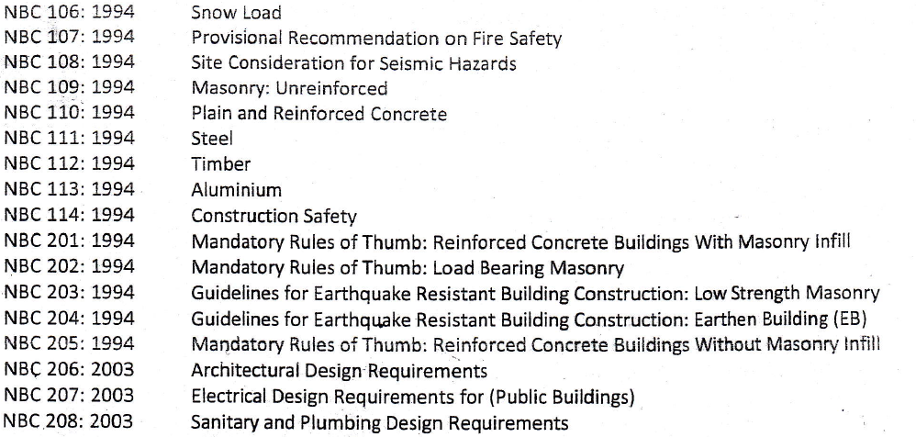

Slide 41
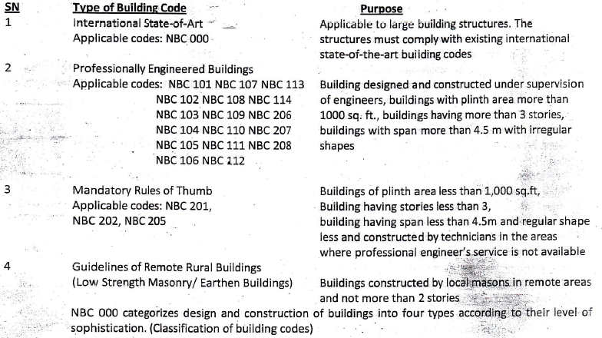
Classification of NBC according to their uses

Slide 42
International State of Art
The major thrust of the code is aimed at the typical and most common buildings currently being constructed in Nepal.
It does not suggest as being practical for everyday consideration the sophisticated design analytical techniques that appear in the building codes of developed countries.
Under the first category International-State-of-the-Art, if consultants ensure that their designs meet corresponding international standards, the designs are considered to be in conformity with NBC.

Slide 43
Professionally Engineered Building
It covers all usual structures such as hospitals, meeting halls, factories, warehouses, multi-storey buildings and residential buildings.
Buildings having plan area more than 1,000 S.ft, more than 3 storied and structural span of more than 4.5m which will be constructed under design and supervision of engineer falls in this category.

Slide 44
Building of restricted size designed with simple Rule-of-Thumb – Mandatory rules of thumb (MRT)
It refers to buildings of restricted size designed with simple Rule-of-thumb, and mostly applies to remote areas where simpler buildings are prominent.
The requirements are in terms of limit on spans and height, minimum reinforcing and member sizes, position of earthquake-resisting elements and other such rules.

Slide 45
Simple buildings that are constructed where professional engineers and technicians are not available, under supervision of middle level technicians of which plan area is less than 1000 Sq ft, less than 3 storied and structural span is less than 4,5 m tall fall in this category.
NBC 201, 202 and 205 are applicable for building under this category and the code deals with Mandatory rules of thumb load bearing masonry and MRT reinforcement concrete building without masonry infill respectively.

Slide 46
Guideline for remote rural building.
These guidelines address about a dozen typical building styles that have been condensed from an inventory of approximately fifty-five building types surveyed in 1993.
In the form of diagrams and descriptions aimed at technical advisor, house owners and lay-men, these guidelines emphasize those changes that should be made to current practices to improve the seismic resistance of these buildings not subjected to modern quantitative analysis and rational design consideration.

Slide 47
The structures are normally of earthen construction (e.g. unburned masonry, mud-mortar, rubble, dry stone, wattle and daub).
Whereas these recommendation are described as guidelines, it is intended to be mandatory for such structures built in areas controlled by a building permit-issuing local authority.

Slide 48
Building bylaws
There are building bylaws prepared by concerned town development committee and are followed by the municipality of the country.
Building bylaws are prepared to ensure public health safety, planned urban development and planned built environment.

Slide 49
Basic components of building bylaws
Building
Planning
Enforcement

Slide 50
Elements of building bylaws
Right of Way (ROW)
A ROW is a right to make a way over a piece of land, usually to and from another piece of land. A right of way is a type of easement granted or reserved over the land for transportation purpose, such as a footway, carriageway, trail, driveway, rail line or highway. A ROW is reserved for the purpose of maintenance or expansion of existing services with the right-of-way.
In the case of an easement, it may be reverted back to the original owner if the facility is abandoned.

Slide 51
Set Back:
In land use, a setback is a distance which a building or another structure is set back from a street or road, a river or another stream, a shore or flood plain, or any other place which is deemed to need protection.
Depending on the jurisdiction, other things like fences, landscape, septic tanks ,and various potential hazards or nuisance might be regulated.
Setbacks are generally set in municipal ordinance or zoning.

Slide 52
Floor Area Ratio (FAR)
Floor Area Ratio, Floor Space Ratio, Floor Space Index, Site Ratio and plot ratio are all terms for the ratio of a building’s total floor area to size of land upon which it is built.
The terms can also refer to limits imposed on such a ratio.
Formula :
Floor Area Ratio = (Total covered area on all floors of all building on certain plot) / (area of the plot.)

Slide 53
Ground Coverage Ratio
Height of the building
Guidelines for cultural heritage zone
Clearance required for important sites and from other elements.

Slide 54
Elements of building by laws in planning segment
Land use
Size of the plot
Area and its depth and width ratio
Length of cul-de-sac (impasse / dead end)
Area of open space
Public facility requirement.

Slide 55
Elements of building bylaws in Enforcement process segment.
Designing of building stages
Construction stages
Issuance of completion certificate
Use of constructed facility

Slide 56
Business Law
Business : It is the human activities that are related with production of goods and services or sales and purchase of goods and services or exchange of goods and services with a profit making objective.
Law: It is the norms that are drafted and enforces by a state or local government in order to regulate the activities within the state or locality. All the laws that regulate the business law. Ignorance of law will not be excused.

Slide 57
Source of business law in Nepal
English business law
Common law of England
Law of merchants
Principal of Equality
Statue of legislature
Custom and usage
Nepalese statutory act
Judical decisions
Writing and opinions of scholars & commercial treaties and agreements.

Slide 58
Types of business enterprises
Sole ownership
Partnership business organization
Company
Private
Public
Sole business : In this type of business organization, single person establishes, manages, organizes and controls the whole business and also singly liable towards the profit or loss of the business. It is registered under private registration act 2014.

Slide 59
Characteristics of sole business
Sole ownership
Sole management and control
Unlimited liability
Limited areas of operation
Less legal formalities
Voluntary origin and end

Slide 60
Limitation of sole business
Limited capital
Uncertain future
Absence of legal status
Chances of impractical decisions
Lack of specialization
Loss in absence of a key person.

Slide 61
Partnership Business Organization
In this type of business organization, more than one person join their hands to earn profit by investing collectively. This type of business organization is registered under partnership act 2020.

Slide 62
Characteristic of Partnership Business
Joint ownership
Unlimited liability
Shared profit and loss
Established on the basis of agreement between persons
Members do not have separate existence
Joint management and control
Joint agent slip
Partnership right can not be transferred

Slide 63
Limitation of partnership business
Unlimited liability
Uncertain existence
Possibility of misunderstanding and friction between the partners
Limited capital
Difficulty in transferring ownership
Lack of prompt decision
Lack of public faith

Slide 64
Company business organizations
In this type of business organization, company is established under the Act of the country and has limited liability.
Finance is collected through issuance of shares.
Company is considered as an artificial legal person.
Act 2053 regulates the incorporation of a company in Nepal.

Slide 65
Company can further be divided into two as
Private limited company
Public limited company
As per company Act 2053, private limited company has less than 50 shareholders and public limited company shall have minimum 7 share holders and no upper limit.

Slide 66
Characteristics of company business organization
Legal artificial person
Perpetual existence
Limited Liability
Common seal
Voluntary association of person
Capital collected by issuing shares
Transferability of representatives / effective management.
Publication of financial statement
Unlimited capital
Public faith
Unlimited business capability

Slide 67
Limitation of company business organization
Difficulty in formation
Lack of personal interest
Lack of secrecy
Possibility of fraud
Exploitation of shareholders
Group formation of power
Conflict of interest
Absence of prompt decision
Lack of closeness

Slide 68
Cyber law
Cyber law provides the legal framework related to the use of computer, information and communication and the government technology.
It regulates the computer based activities including business (e-commerce) and the government (e-government).
Nepal has enacted the Electronic Transaction Act 2063 (ETA 2063), which comes into effective from December 8, 2006 and electronic transactions rule (ETR 2064) also came into force in 2007.

Slide 69
Electronic Transaction Act
Important terminology defined in ETA 2063. {Self Study}
Important provision of ETA (2063) {Self Study}

Slide 70
The End

